Slide 3
Hagamos inteligentes a tus aplicaciones
Marcos Lora Rosa
@magicheron

Slide 4

Innovation

Slide 5
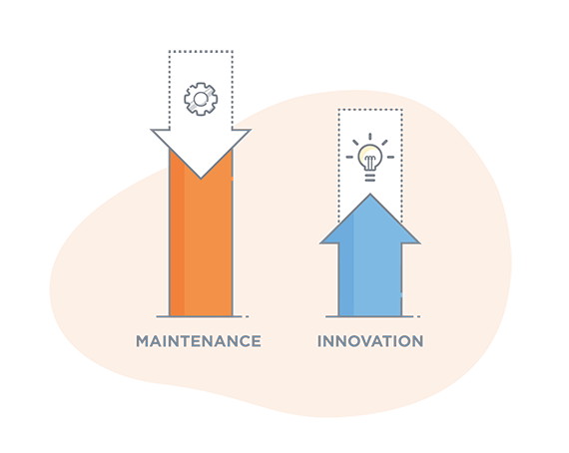
Innovation

Slide 6

ML Types

Slide 7





Frameworks & Algoritms

Slide 8




Interoperability

Slide 9
Windows ML

Slide 10
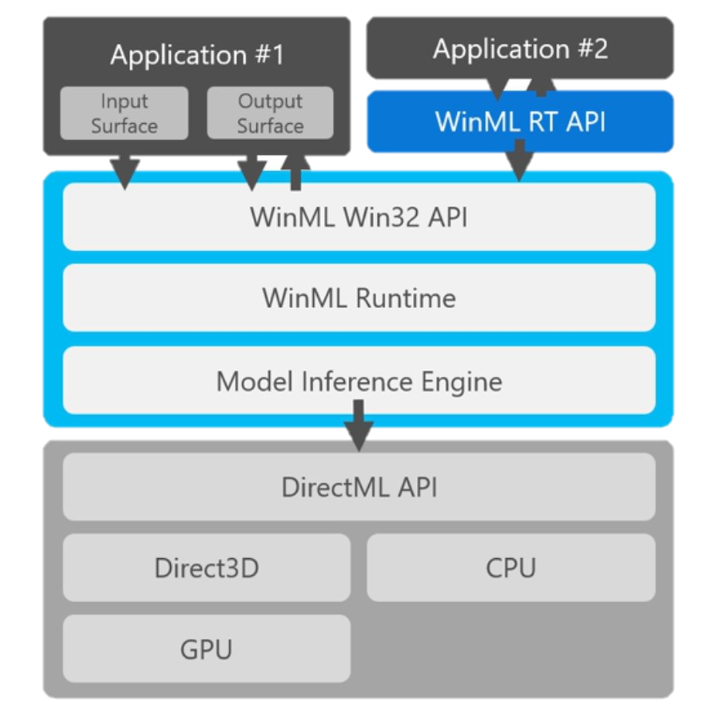
Windows Machine Learning

Slide 11
MNIST Demo

Slide 12
MXNet Model Server

Slide 13
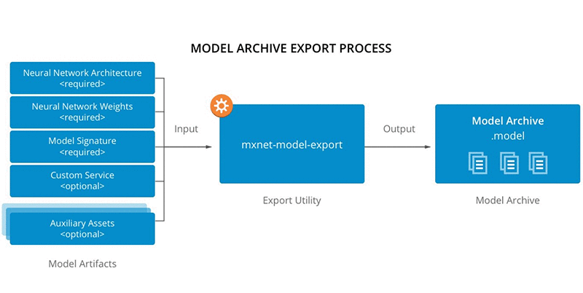
MXNet Process

Slide 14

Model Serving

Slide 15
Squeezenet Demo

